Slide 1
ML for optimal stopping of Brownian motion

Slide 2
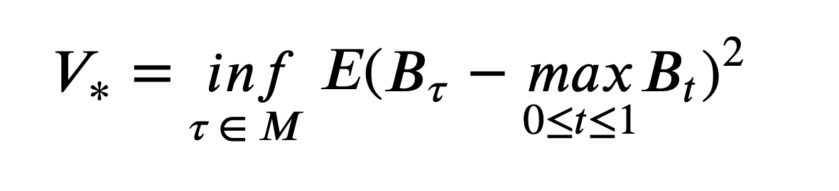
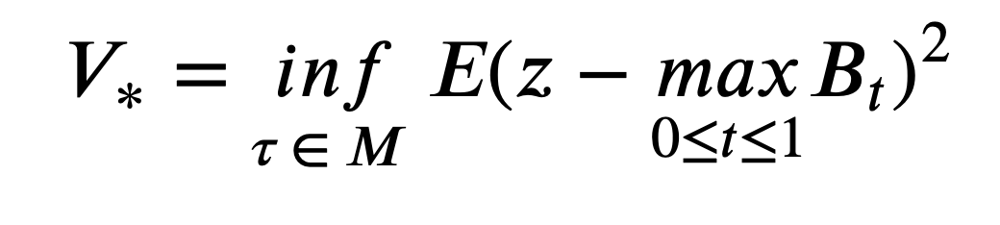
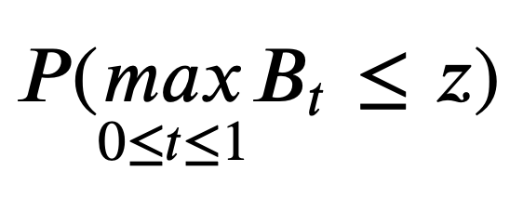
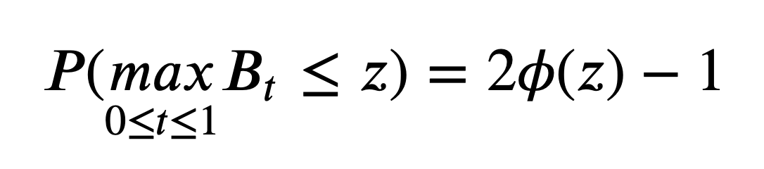
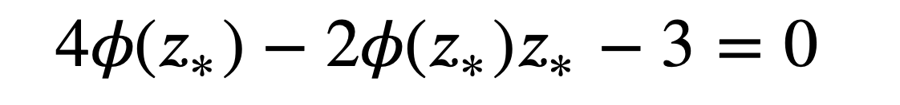
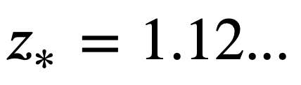

Initial problem
We want to find $z$that describes $B_{τ}$
How it can be solved?
Step 1: find explicitly the probability that maximum is less than a threshold
Results from the article
Using the following equation find needed threshold:

Slide 3

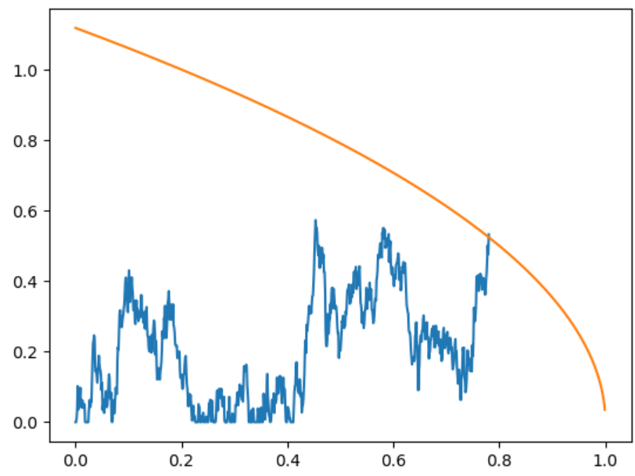
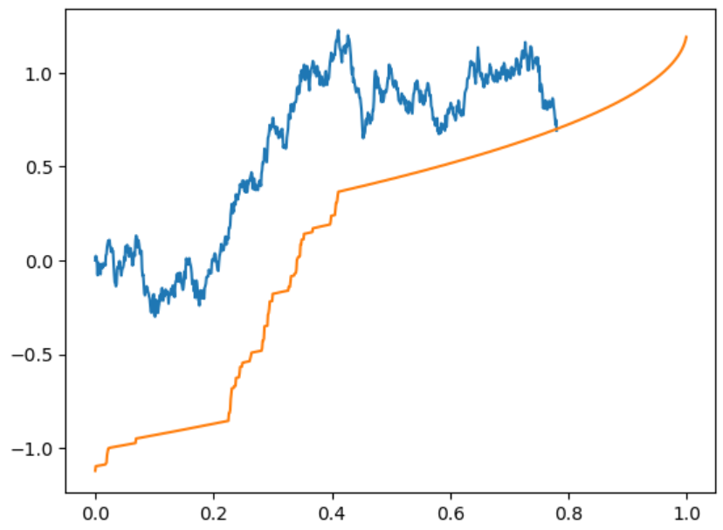
Use found level to form optimal stopping rule

Slide 4
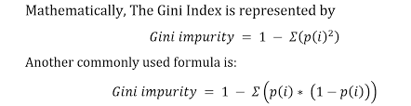
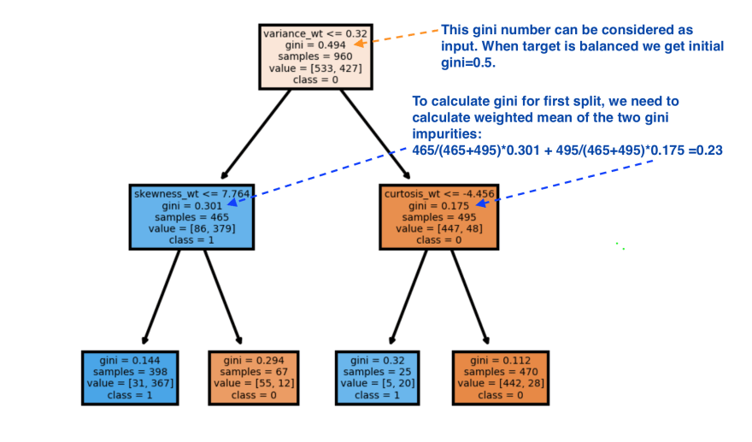
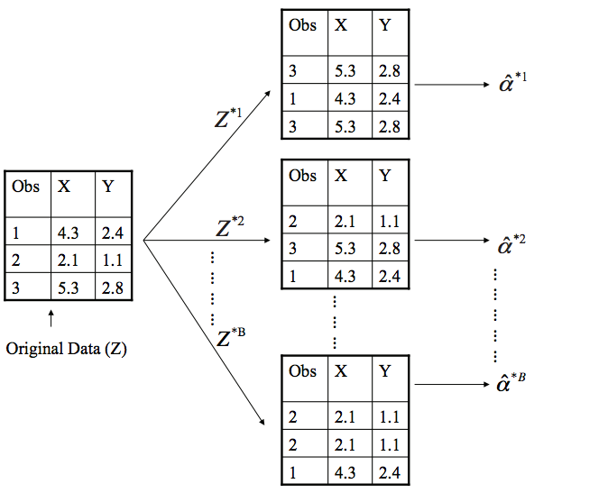
Some ML theory
Split criterion
Decision tree
Bootstrap

Slide 5
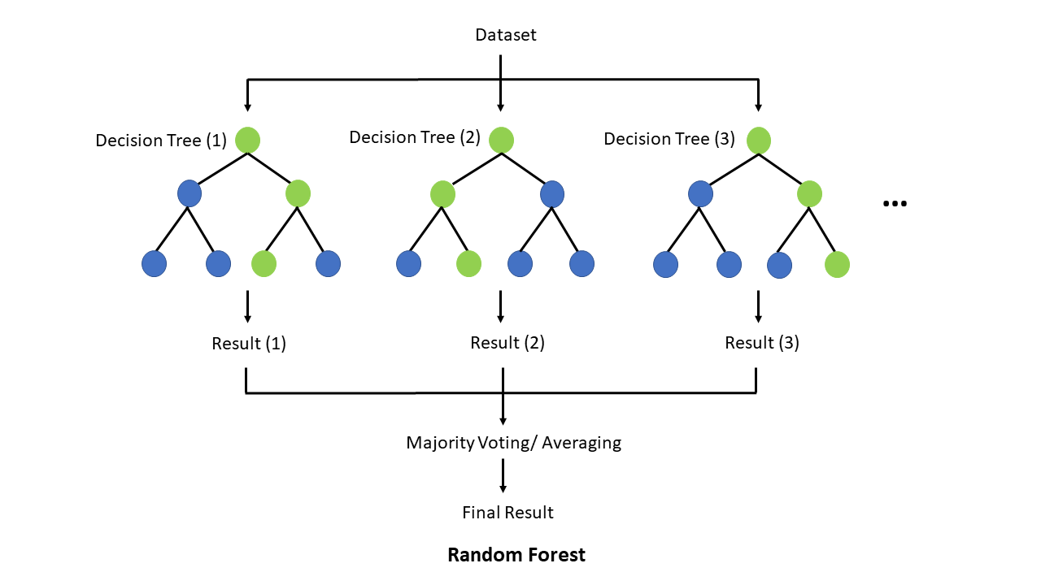
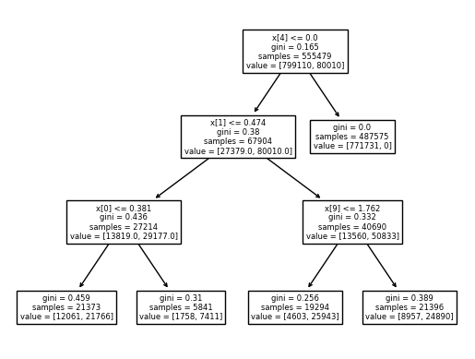
Random forest
Scheme
Actual example

Slide 6
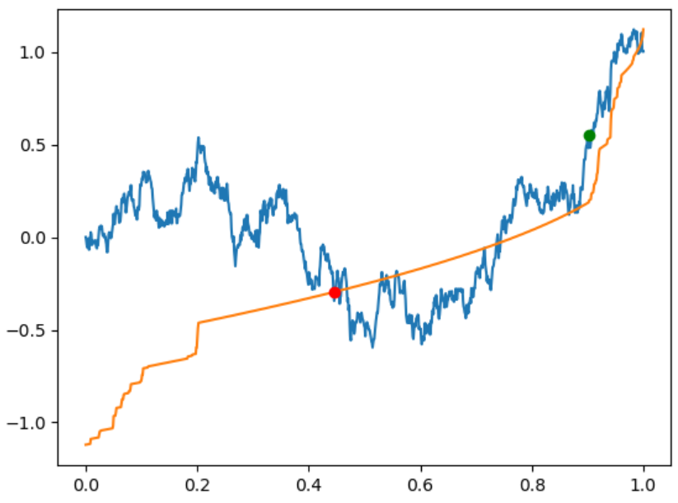
Examples of predictions

Slide 7
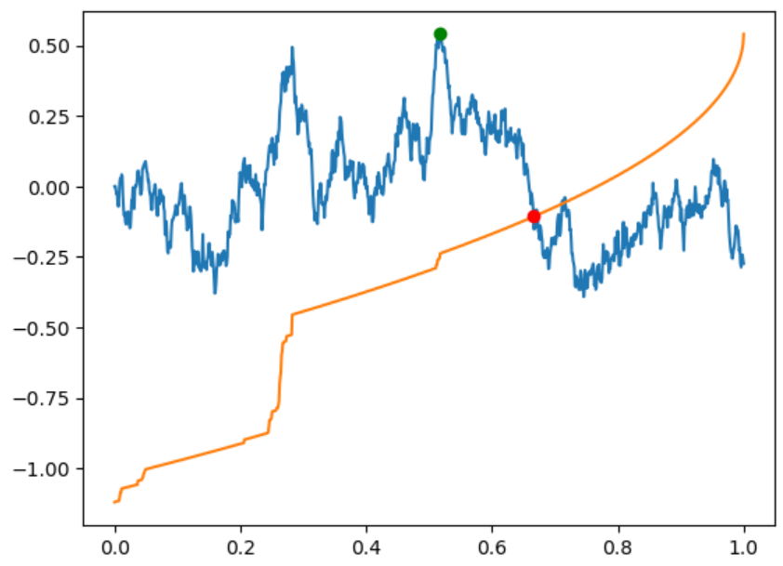
Examples of predictions

Slide 8
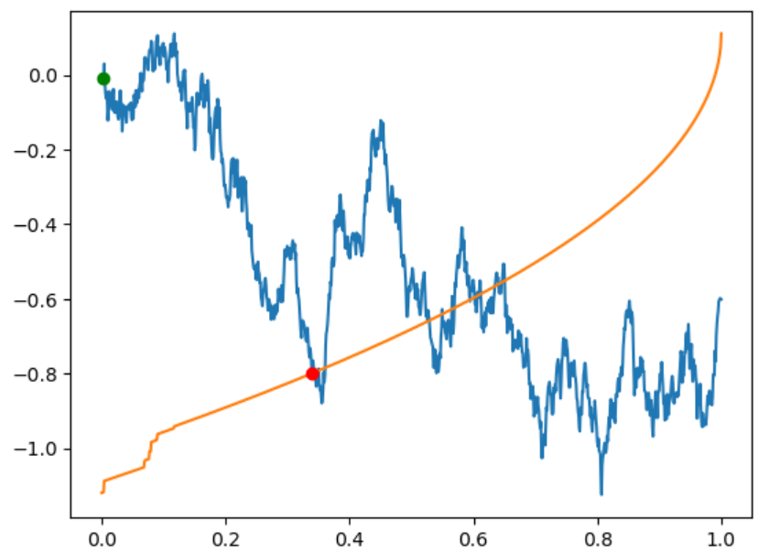
Examples of predictions

Slide 9
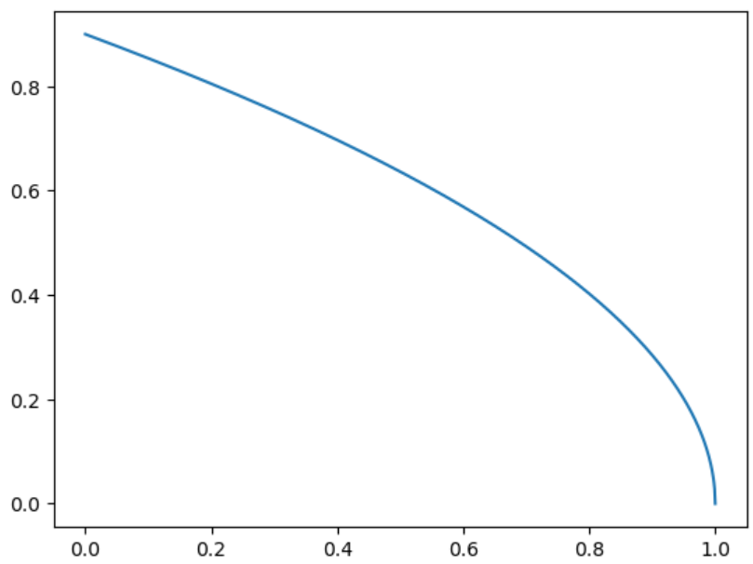

Prediction approach
Dynamic probability threshold
Balance the set
Predict probability
Compare with the benchmark
Train the model
Tune the tree
$$threshold ∗\sqrt{1−t}$$

Slide 10
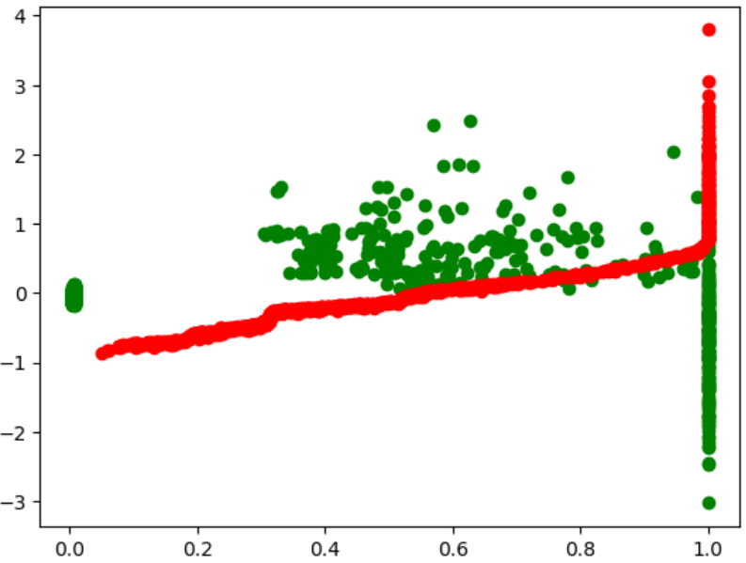
Left to fix
Results of testing the ML approach
Falling trajectories are still an issue:
Add stopping condition to avoid skipped trajectories (new variables, non-ML stopping criterion)
Adjust the probability threshold
Use additional model or criterion to have two-sided filter
Test another models

